Slide 1
Rotated Object Detection in Aerial Images
Konstantinos Papadakis
k.i.Papadakis@gmail.com

Slide 2
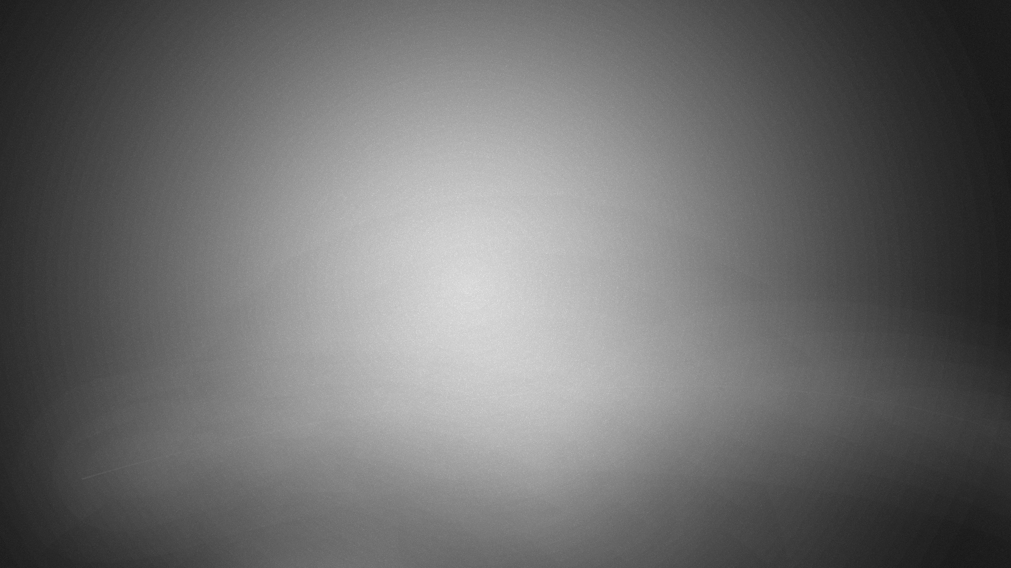
The DOTA v1.0 Dataset

Slide 3
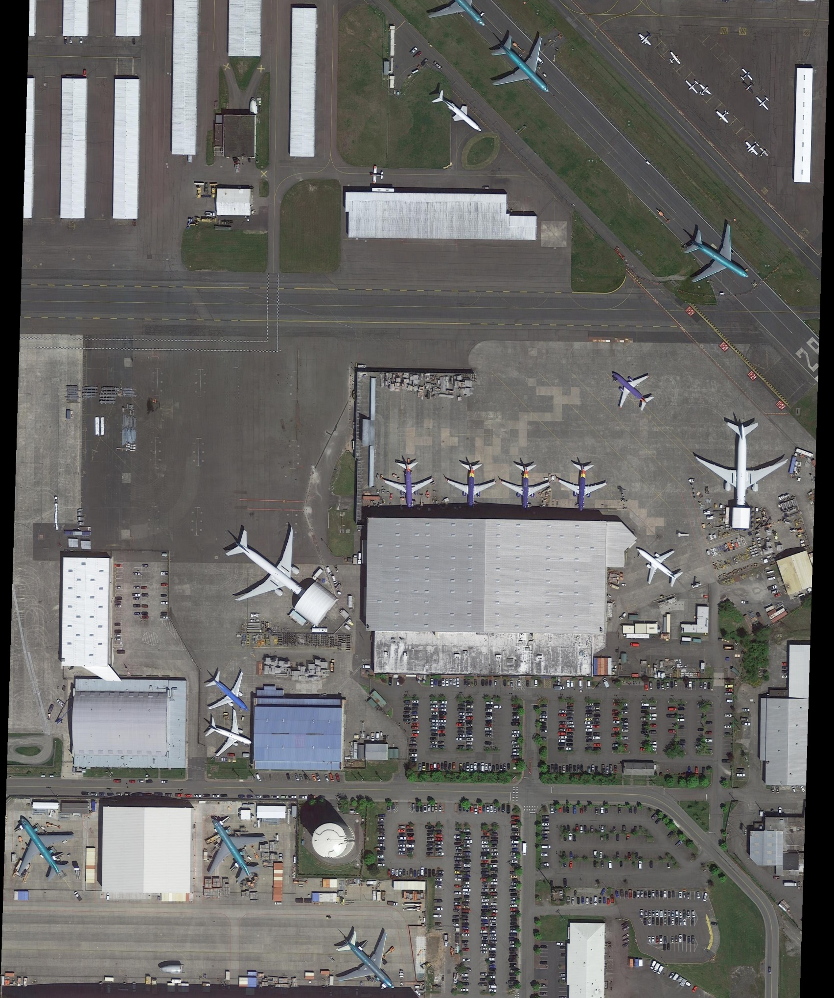
The DOTA v1.0 Dataset
A large-scale dataset for rotated object detection in aerial images
Commonly used as a benchmark
Image size ranging from 800×800 to 20,000×20,000 pixels
20GB of images
2,806 images, 188,282 instances
1/2, 1/6, 1/3 train-validation-test split

Slide 4
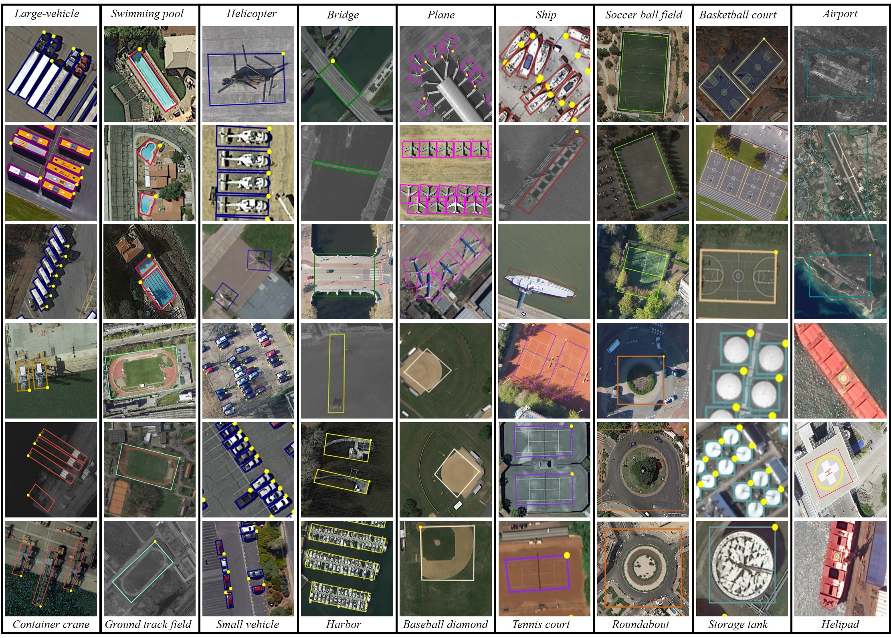
15 classes

Slide 5
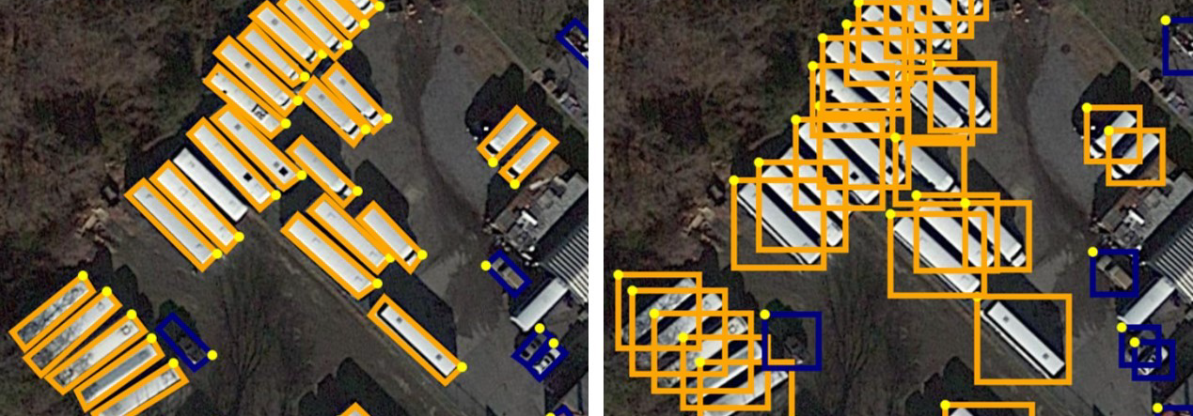
Oriented vs Horizontal Bounding Boxes
In aerial images, objects are often arbitrarily oriented due to the bird’s eye view and larger scale variations when compared to natural images.
Crowded instances represented by horizontal bounding boxes (HBBs) are difficult to distinguish.
Oriented Bounding Boxes (OBBs) are a better fit for aerial images.

Slide 6
DOTA v1.0 Statistics
Category | Number of Instances
Plane | 14,085
Baseball Diamond | 1,130
Bridge | 3,760
Ground Track Field | 678
Small Vehicle | 48,891
Large Vehicle | 31,613
Ship | 52,156
Tennis Court | 4,654
Baseball Court | 954
Storage Tank | 11,794
Soccer Ball Field | 720
Roundabout | 871
Harbor | 12,287
Swimming Pool | 3,507
Helicopter | 822

Slide 7
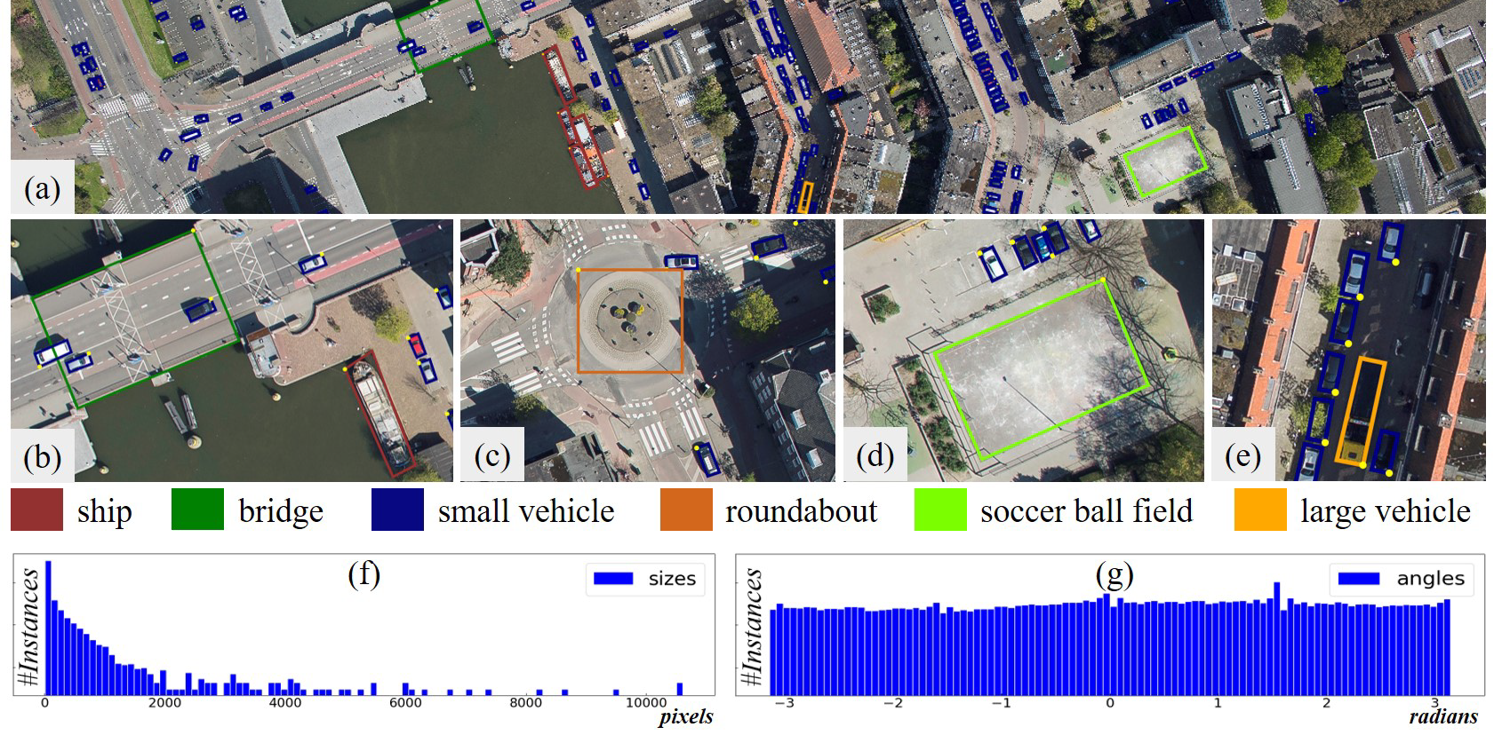
DOTA v1.0 Statistics
(a) A typical image in DOTA consisting of many instances from multiple categories.
(b), (c), (d), (e) are cropped from the source image.
(f) and (g) exhibit the size and orientation histograms, respectively, for all instances.
Source: https://arxiv.org/abs/2102.12219

Slide 8
Oriented Object Detection Algorithms

Slide 9
Benchmarks
Commonly used models are available in the MMRotate toolbox https://mmrotate.readthedocs.io/en/latest/model_zoo.html
Benchmarks of popular models using ResNet50 as their backbone and 1024×1024 patches with 200 overlap are shown in the table (source: MMRotate)
Model | mAP | Inference FPS | Year
Rotated RetinaNet | 68.42 | 16.9 | 2017
Rotated ATSS | 70.64 | 18.2 | 2020
Gliding Vertex | 73.23 | 16.4 | 2020
Rotated Faster RCNN | 73.40 | 16.5 | 2017
Oriented RCNN | 75.69 | 16.2 | 2021
RoI Transformer | 76.08 | 14.4 | 2019

Slide 10
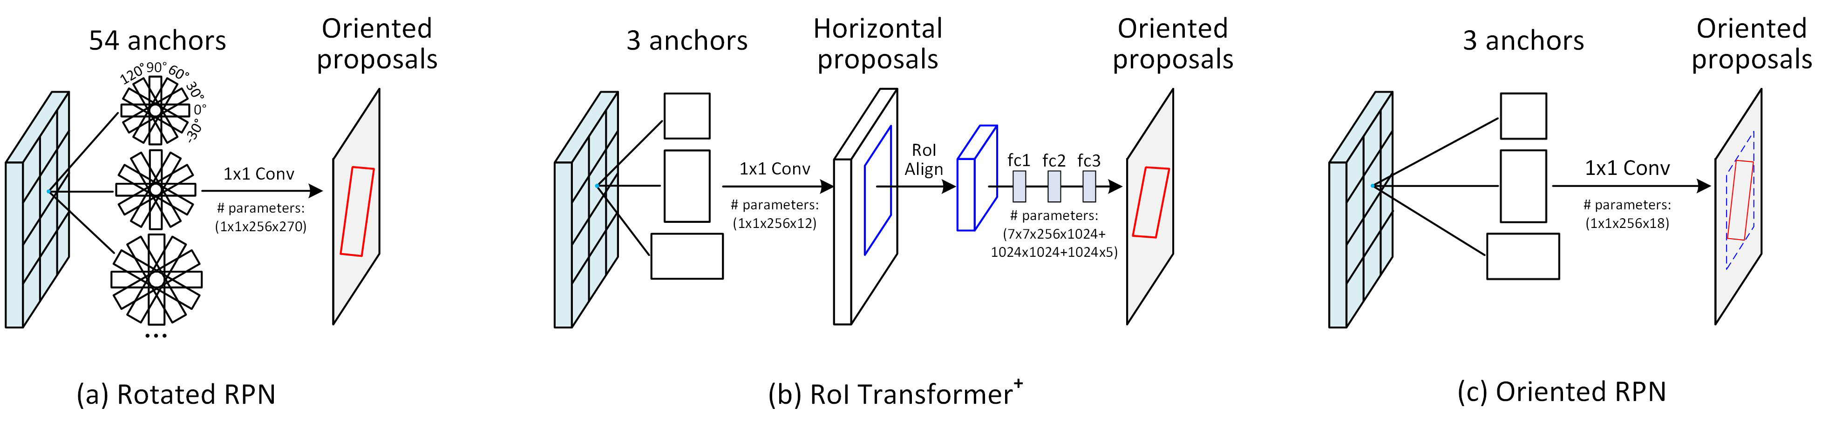
RPN variations

Slide 11
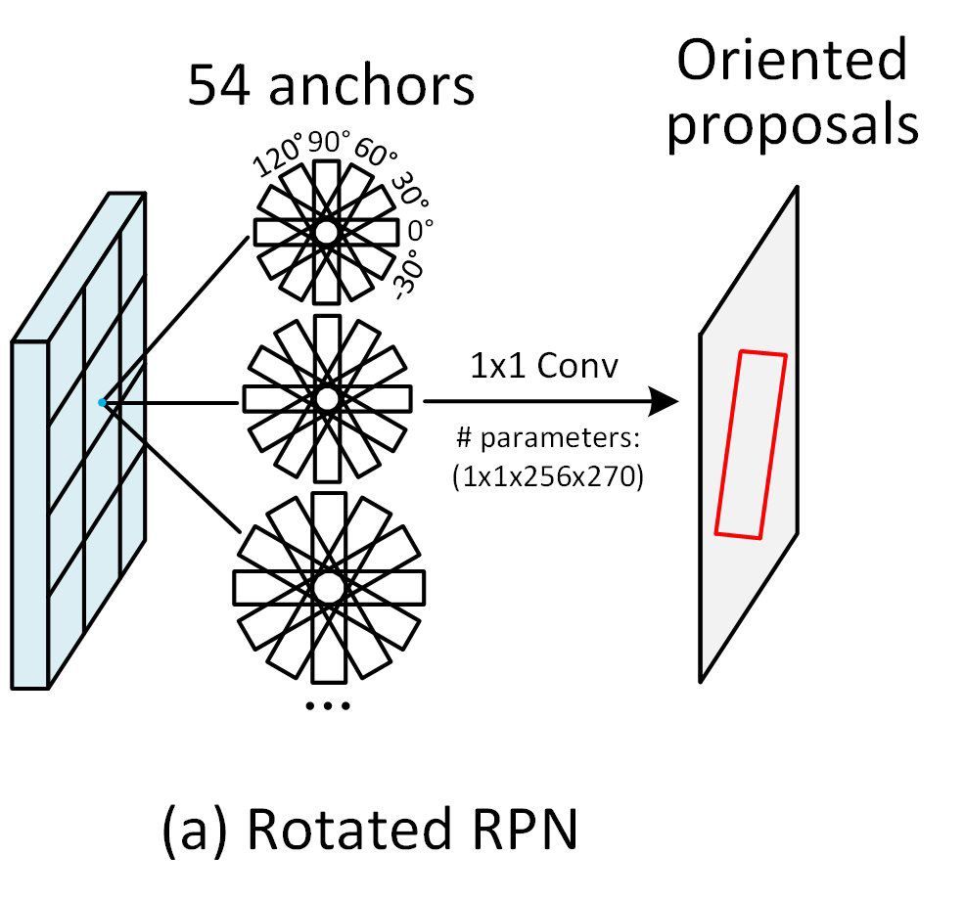
Rotated RetinaNet and Rotated Faster RCNN
Created by modifying the original HBB architectures
The RPN, instead of generating a fixed set of horizontal anchors, it now generates a fixed set of oriented anchors. These anchors are described by their center, height, width and angle.
The bounding box regressors now also include an angle delta.
The RoI Alignment is modified to Rotated RoI Alignment and now works with OBBs.

Slide 12
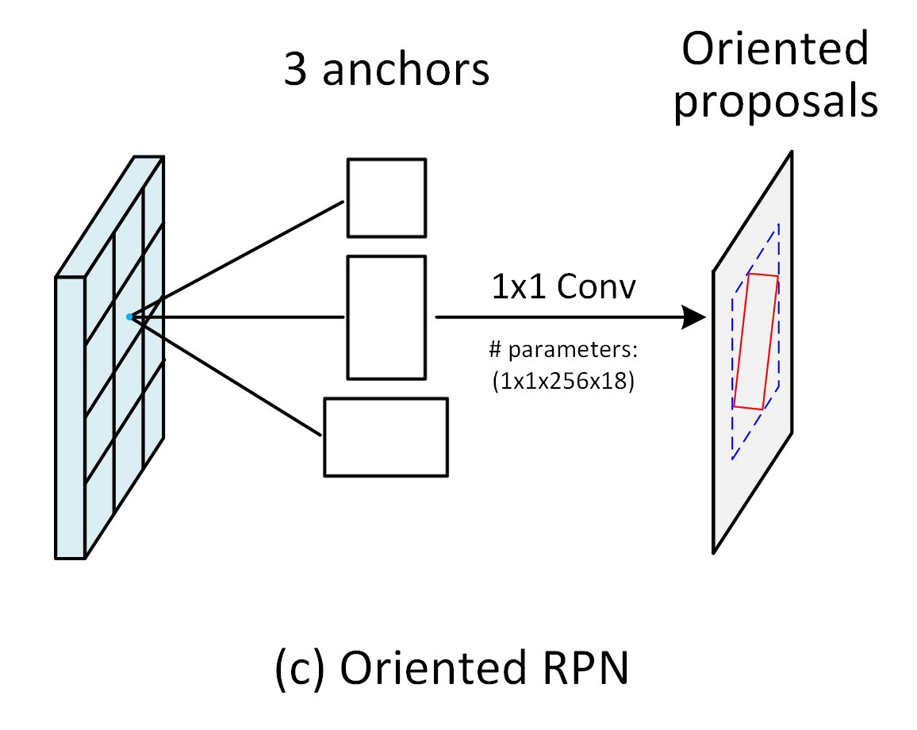
Oriented RCNN
Like Rotated Faster RCNN but with different RPN.
The anchors are horizontal, but the proposals are parallelograms contained inside the anchors.

Slide 13
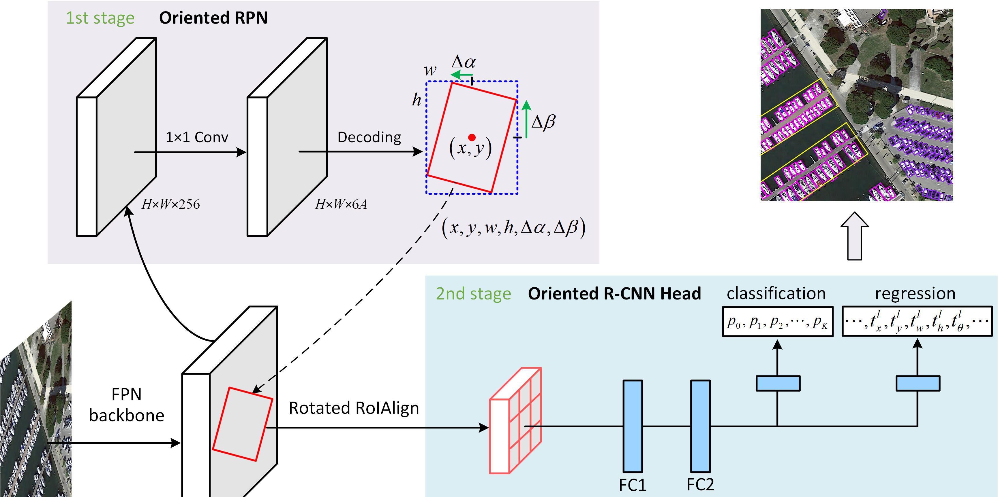
Oriented RCNN
The box regressor generates a delta for the center, height and width of the horizontal anchor, as well as two deltas that are used to create offsets Δα and Δβ relative to the midpoints of the top and right sides of the horizontal anchor.
Each proposal is a parallelogram represented by 6 numbers: the center, height, width and two offsets. This representation is called Midpoint Offset Representation.

Slide 14
Oriented RCNN
To utilize Rotated RoI Alignment, the parallelogram proposals are transformed to rotated rectangles by extending the shorter side of the parallelogram.
The remaining stages of the model are the same as Rotated Faster RCNN.

Slide 15
The MMRotate Library

Slide 16
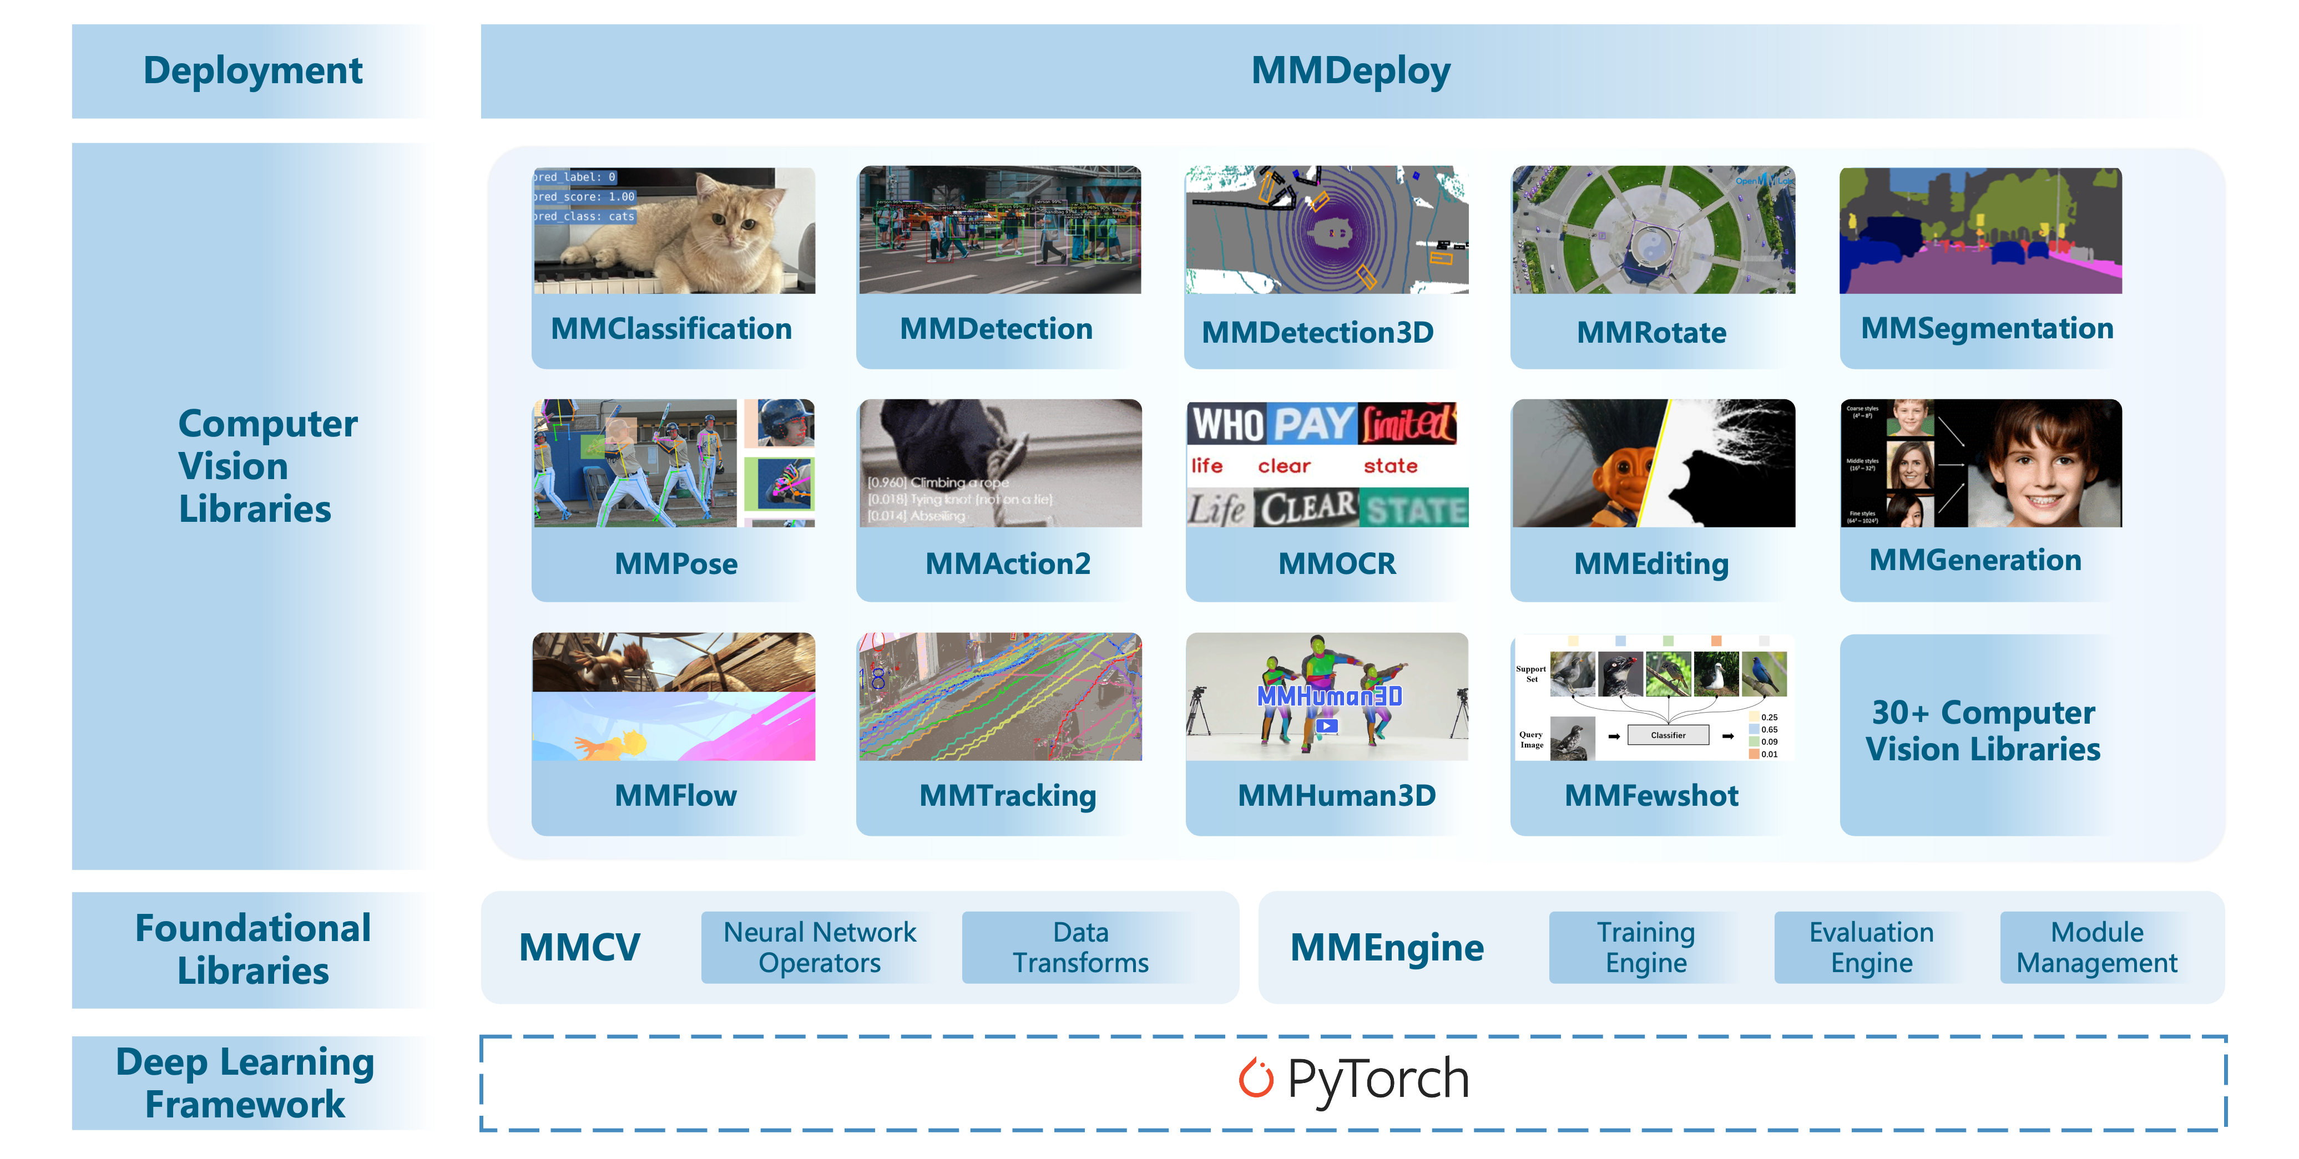
The MMRotate Library
MMRotate is part of a bigger project called OpenMMLab, and its application is rotated object detection.
It is based on MMDetection, which in turn is based on MMCV, a library based on PyTorch.

Slide 17
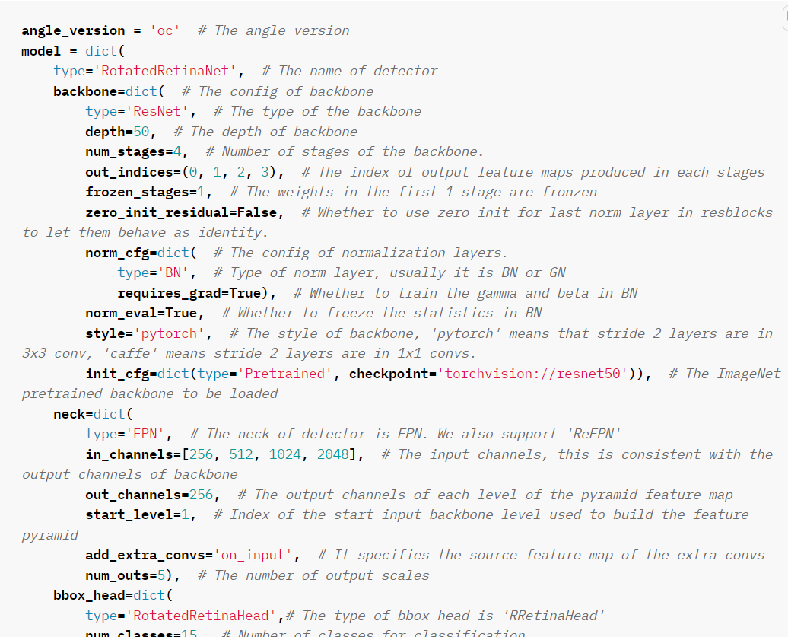
Configuration Files
To use any OpenMMLab library, one must specify configuration files (JSON, YAML, or Python files) which contain instructions for the data loading process, the model and the runtime.
Part of a Python configuration is shown in the image

Slide 18
Preprocessing the Dataset
The dataset needs to be an appropriate format. Most often it is the case that one transforms a dataset into the “DOTA format” and utilize the predefined DOTADataset class.
If the images are large, one needs to crop the dataset into patches. This can be achieved by using scripts provided in the MMRotate GitHub repository. The script is tools/data/dota/split/img_split.py
MMRotate also provides functions to reassembly patch predictions by using Non-maximum Suppression (NMS).

Slide 19
Training and Testing the Model
After specifying the configurations and bringing the dataset into an appropriate format, the model can be trained by running a script provided in the MMRotate GitHub repository with the configuration file path as an argument. The script is tools/train.py
The model can be tested by running tools/test.py with the configuration and model checkpoint paths.

Slide 20
Results

Slide 21
Data Preprocessing
Each image was cropped into 1024 × 1024 patches with an overlap of 200.
Before feeding the image to the network, the following transforms were applied:
Transform gray images to RGB by repeating the gray channel
Image normalization using the default ResNet50 transforms
Resize the image to 1024 ×1024 using bilinear interpolation (training only)
Random horizontal, vertical and diagonal flip (training only)

Slide 22
Rotated RetinaNet Structure
ResNet50 backbone pretrained on ImageNet with the final 4 out 5 layers being trainable.
The anchors are all with zero angle, due to MMRotate’s implementation (see mmrotate.core.anchor.anchor_generator.AnchorGenerator)
Samples are assigned as positive if they have OBBs with IoU > 0.5 with the ground truth OBBs, and negative if IoU < 0.4.
Focal loss gamma=2.0 and alpha=0.25.

Slide 23
Rotated RetinaNet Runtime
The model was trained for 13 epochs (7 hours and 13 minutes).
The batch size was equal to 3.
Simple SGD with momentum 0.9 was used.
Weight decay with a coefficient of 0.0001
Gradient clipping when L2 norm > 35.
The learning rate starts at 0.025/3 and grows linearly to 0.025 after 500 iterations (=1500 images). On epochs 8 and 11, the learning rate is divided by 10.

Slide 24
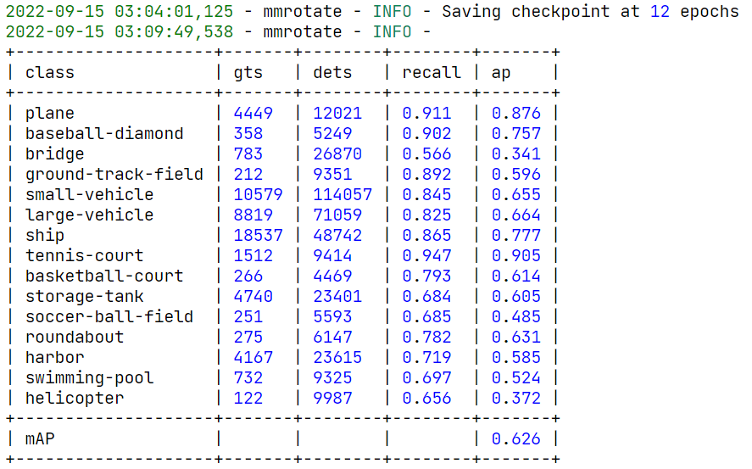
Rotated RetinaNet Metrics
The best mAP (=0.6259) was achieved on epoch 12.

Slide 25
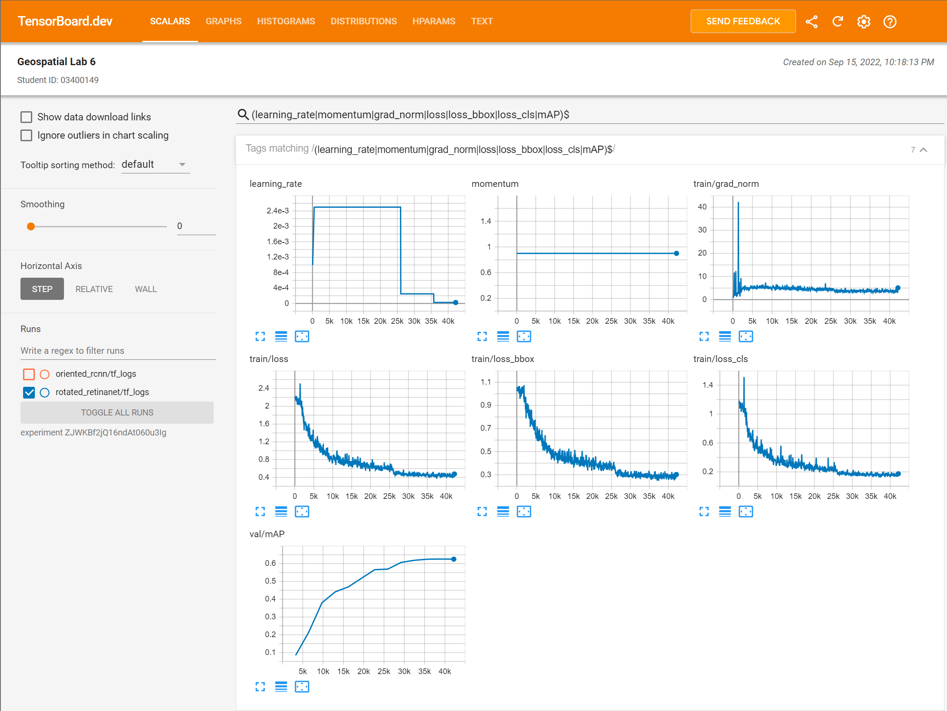
Rotated RetinaNet Learning Curves
https://tensorboard.dev/experiment/ZJWKBf2jQ16ndAt060u3Ig/

Slide 26
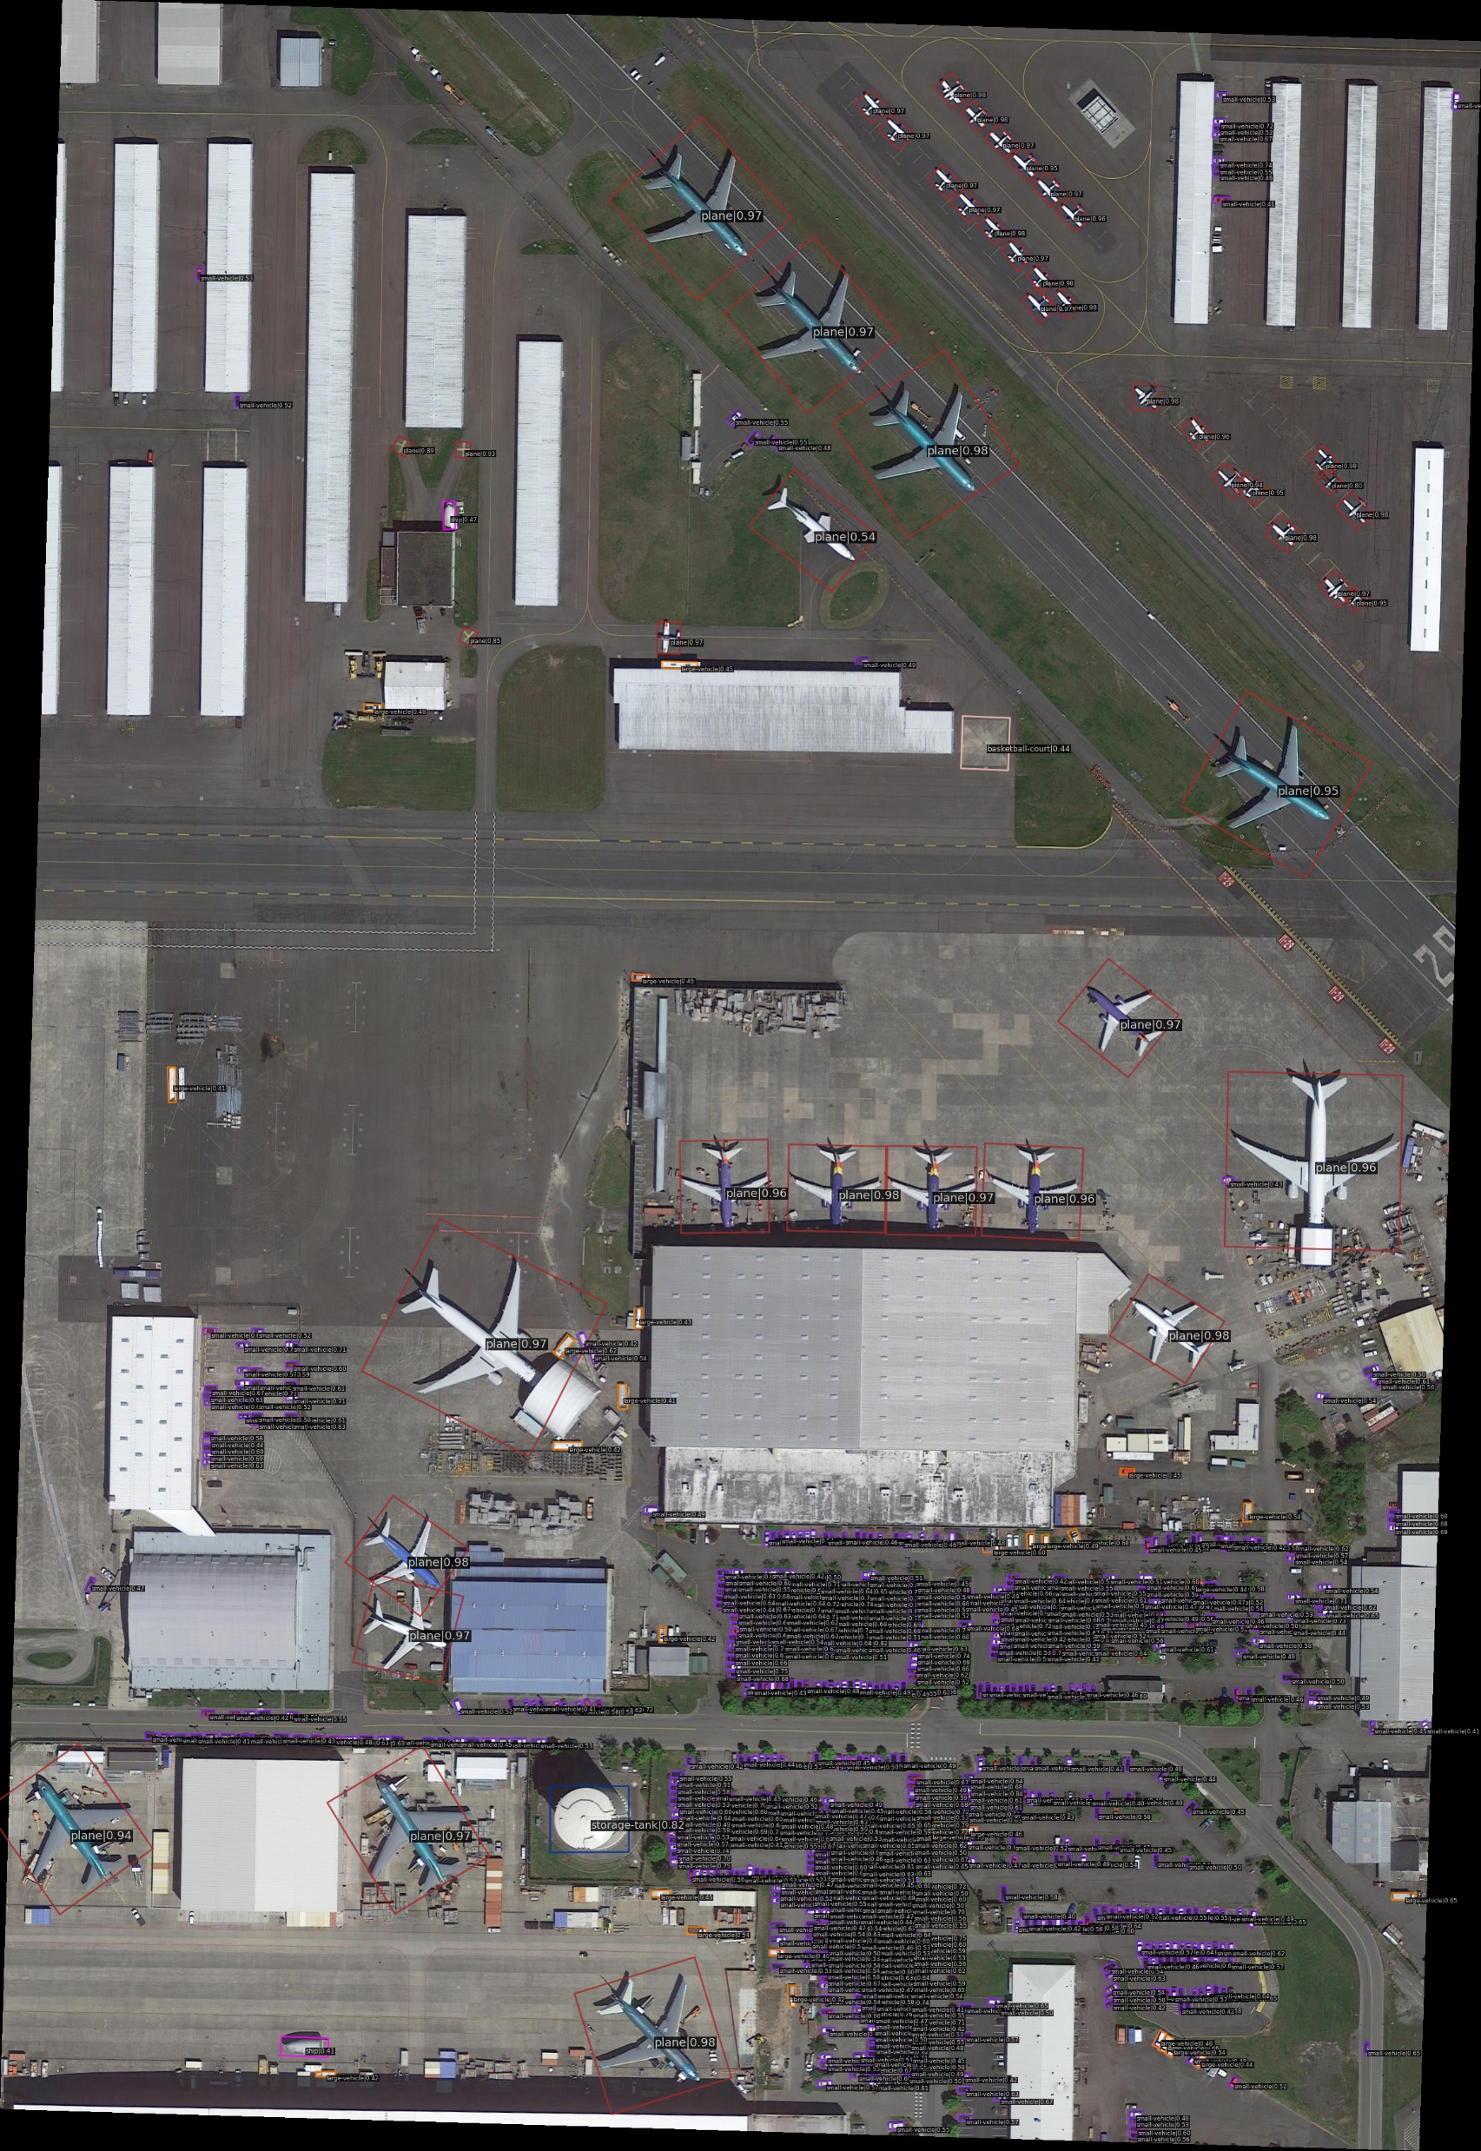
Rotated RetinaNet Predictions

Slide 27
Oriented RCNN Structure
A ResNet50 with the same settings as in Oriented RetinaNet was used.
Samples are assigned as positive if they have OBBs with IoU > 0.7 with the ground truth OBBs, and negative if IoU < 0.3.

Slide 28
Oriented RCNN Runtime
The same runtime as in Rotated RetinaNet was used

Slide 29
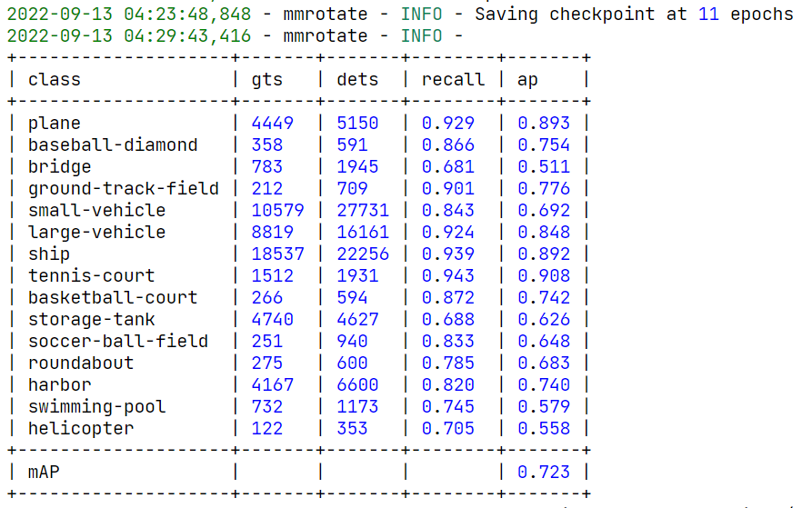
Oriented RCNN Metrics
The best mAP (= 0.7233) was achieved on epoch 11.

Slide 30
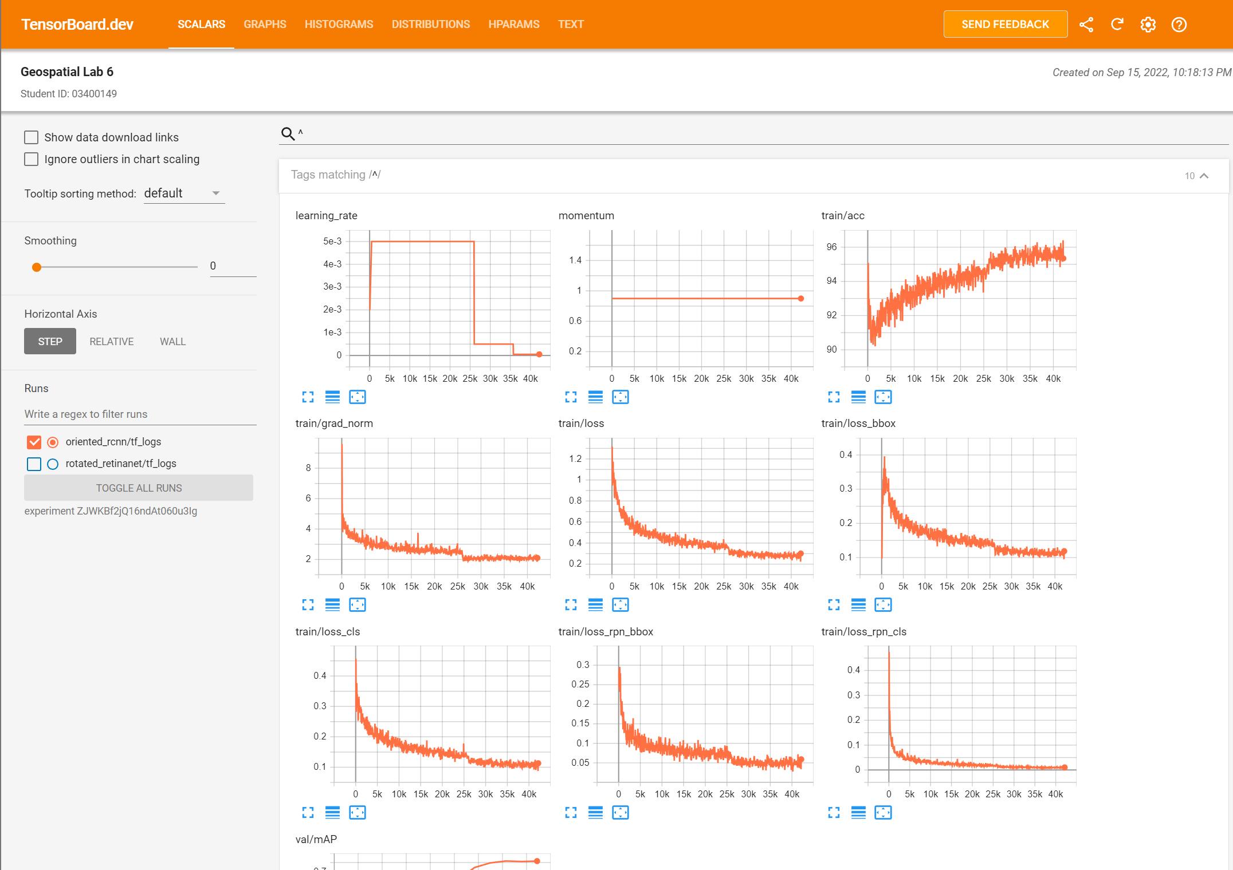
Oriented RCNN Learning Curves
https://tensorboard.dev/experiment/ZJWKBf2jQ16ndAt060u3Ig/

Slide 31
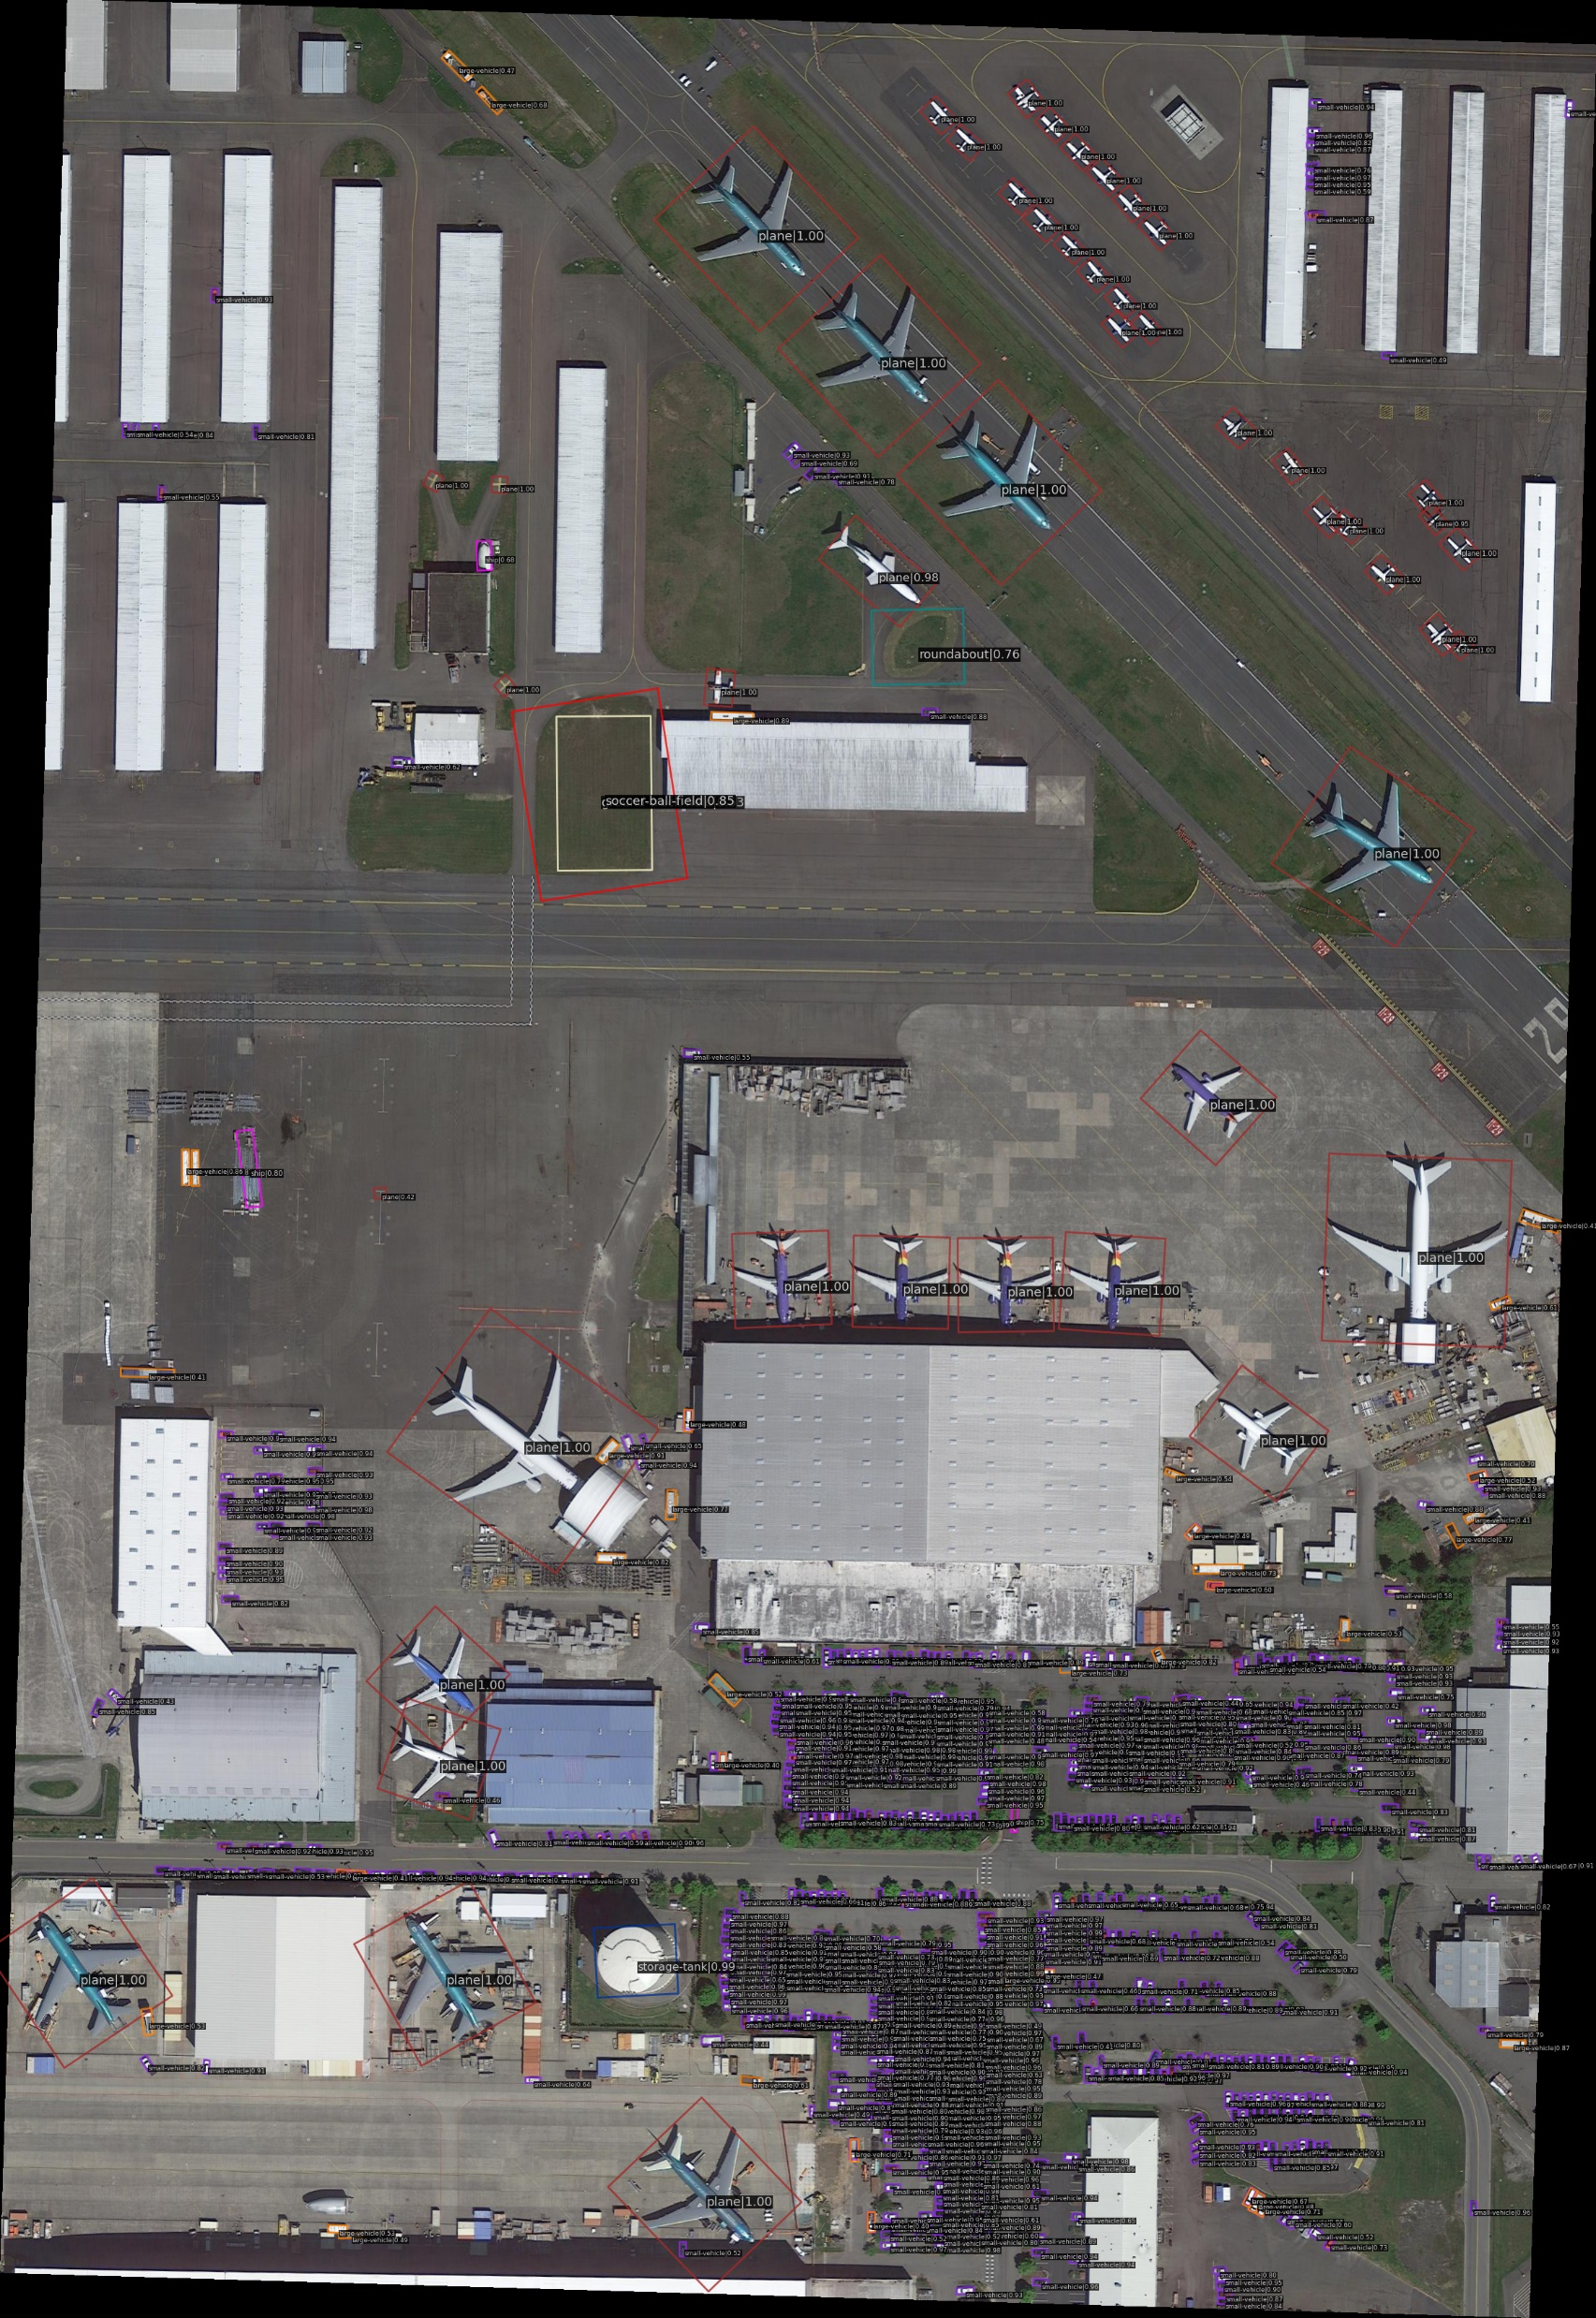
Oriented RCNN Predictions

Slide 32
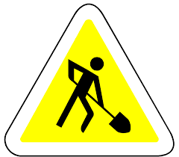
Work in progress…

